Slide 1
Analysis of Real-Time Hostile Activity Detection from Spatiotemporal Features Using Time Distributed Deep Convolutional Neural Networks, Recurrent Neural Networks and Attention-Based Mechanisms
Thesis Students:
Labib Ahmed Siddique 18101478 Rabita Junhai 18101259 Moshfeka Islam 18101432 Shafinaz Qader 18141006
Supervisor:
Dr. Amitabha Chakrabarty, PhD
Co-Supervisors:
Tanzim Reza
Tanvir Rahman
Department of Computer Science and Engineering
BRAC University

Slide 2
BACKGROUND
Why do we need video surveillance system?
How use of HAR (Human Action Recognition) will be introduced to implement the system?
Why is Deep learning based method introduced?

Slide 3
PROBLEM STATEMENT
Unable to detect violent action
Absence of automated alert
Increase in crime rate, due to lack of evidence

Slide 4
RESEARCH OBJECTIVE
To correctly classify the extracted features and train deep-learning models to distinguish between normal and abnormal human behavior.
To create deep learning models to detect violent or non-violent human behavior in an automated way.
To process raw CCTV footage to extract features so that it can help us classify normal human activity from abnormal human activity.
To make a real-time monitoring system with the help of IoT that will be cost-efficient, safe, and more effective than the existing surveillance systems.

Slide 5
Literature Review and Related Works:
“Video facial emotion recognition based on local enhanced motion history image and CNN-CTSLSTM networks”
- Min et al. (2018)
Implementation of LEMHI and CNN-LSTM model to emphasize facial emotion identification.
VGG-16 was treated as a feature extractor.
CK+, MMI, and AFEW datasets were used.
Achieved an accuracy of 93.9% for CK+, 78.4% for MMI, 51.2% for AFEW.

Slide 6
Literature Review and Related Works:
“Spatial-temporal Convolutional Neural Networks for Anomaly Detection and Localization in Crowded Scenes”
-Zhou et al. (2016)
Implementation of coupling of anomaly detection with spatial-temporal Convolutional Neural Networks(CNN).
Spatial-temporal CNN structure consists of 8 layers.
Applied spatial-temporal convolution with a 3D kernel size of 3×3×3 on the input data.
Achieved perfect performance and reaches 99.63% under the AUC criterion.

Slide 7
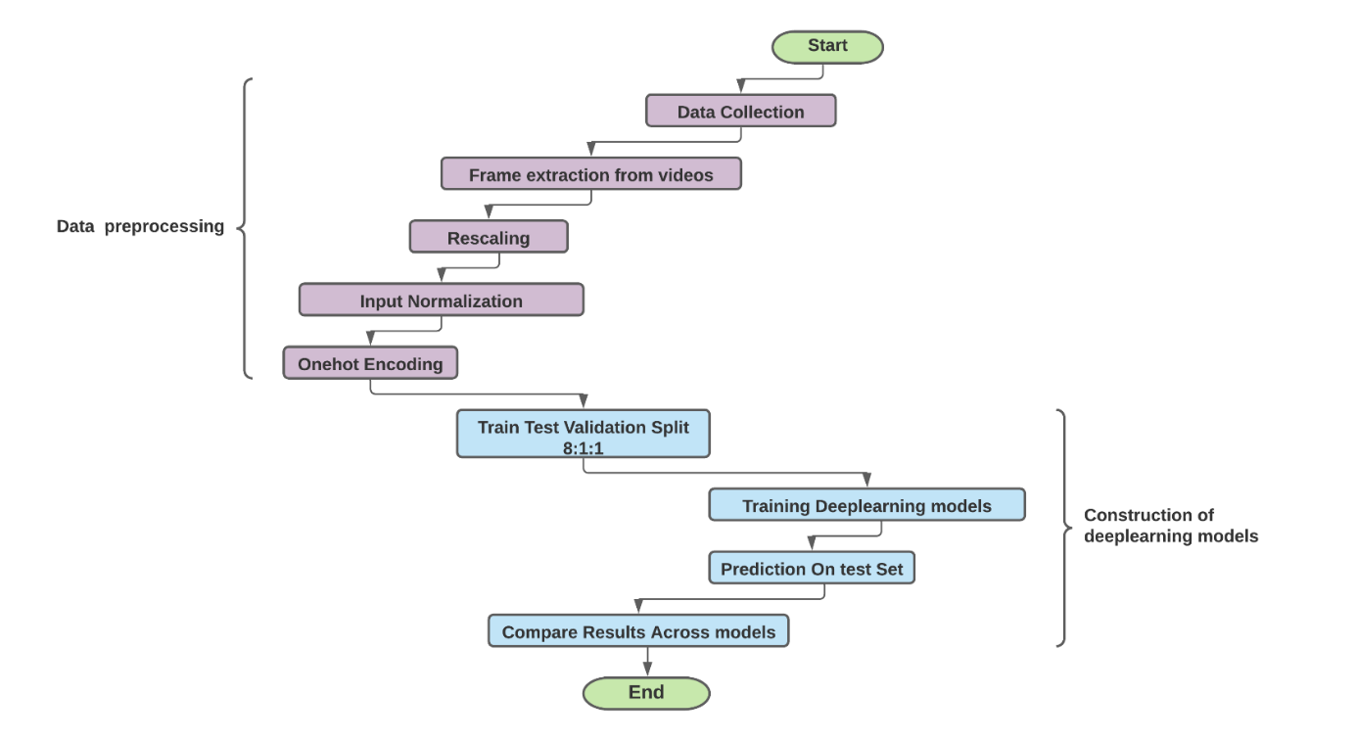
Proposed Model and Work Plan:
Figure: The flow chart of the proposed hostile behaviour detection model

Slide 8
Data Preprocessing:
Data collection
Frame extraction from videos
Rescale the data
Normalize input
Onehot encoding for labeling

Slide 9
Constructing of Deep Learning Models:
Train test validation split
Training deep learning models
Predict on the test set
Compare results across models

Slide 10
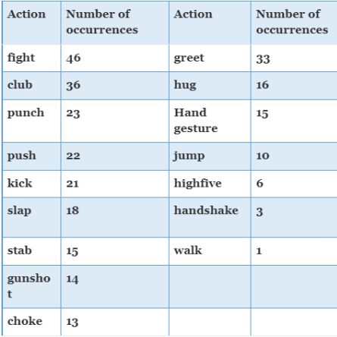
Data Collection
Data was collected from a research dataset by Bianculi el al.
Videos are obtained from two different cameras.
Takes false positive results into consideration.
Fig: This is the list of the recorded actions, with the number of occurrences in the dataset

Slide 11
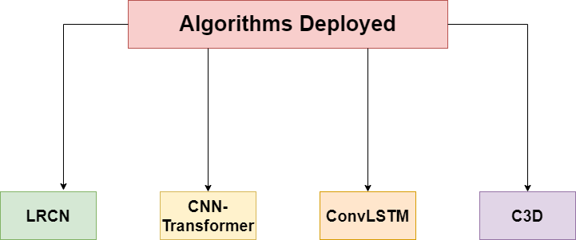
Algorithms
Figure: Algorithms deployed

Slide 12
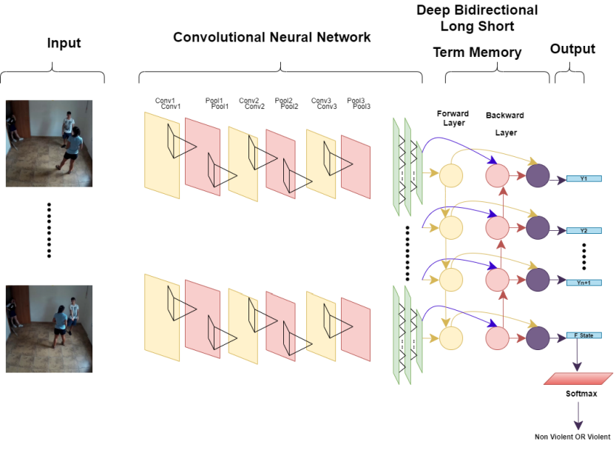
Long-term Recurent Convolutional Network
Deployed a custom CNN feature extractor model with accuracy 83.33%.
Experimented with pre-trained model like VGG-16 with accuracy 70%.
Figure: LRCN Architecture

Slide 13
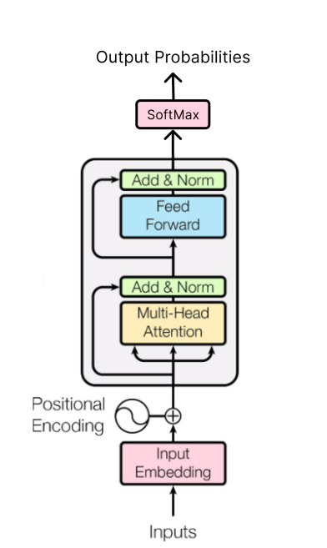
Convolutional Neural Network Transformer
Combination of CNN and Transformer model.
Input to Transformer requires positional embedding.
Model accuracy is 76.6%.
Figure: Encoder Block of the Transformer

Slide 14
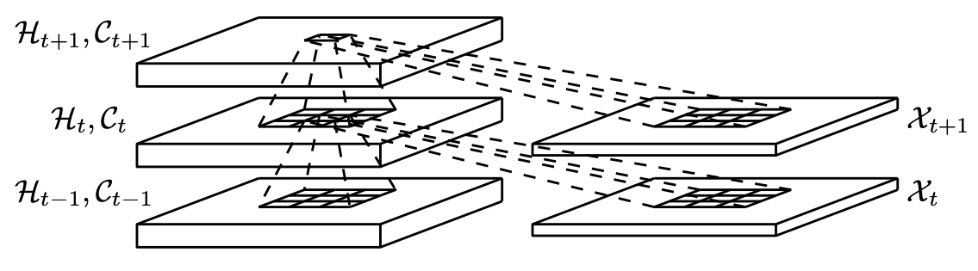
Convolutional Long Short Term Memory
Recurrent Neural Network for spatio-temporal prediction.
Accuracy is 80%.
Figure: Inner Structure of ConvLSTM

Slide 15
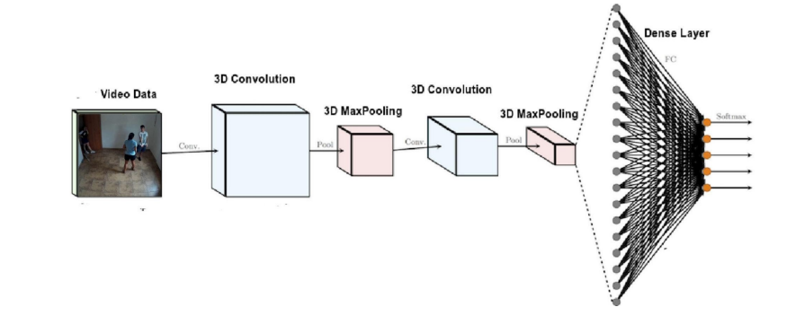
3D-Convolutional Neural Network
Performs convolutional operations over volume.
Accuracy is 80%.
FIGURE: 3D-CNN (C3D) Architecture

Slide 16
IMPLEMENTATION
DATA PREPROCESSING:
Create function to extract 25 frames from a single video
Make the frame selection dynamic, resize and append
Create a 3D dataset ,One hot encode the label, normalize the features
Fig:Before preprocessing
Fig:After preprocessing

Slide 17
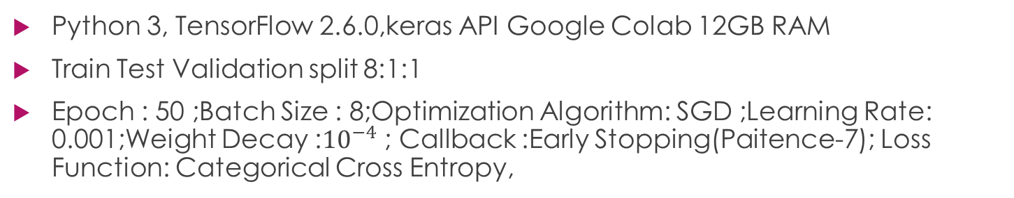
IMPLEMENTATION
TRAINING INFORMATION :
Python 3, TensorFlow 2.6.0,keras API Google Colab 12GB RAM
Train Test Validation split 8:1:1
Epoch : 50 ;Batch Size : 8;Optimization Algorithm: SGD ;Learning Rate: 0.001;Weight Decay :${10}^{−4}$ ; Callback :Early Stopping(Paitence-7); Loss Function: Categorical Cross Entropy,
Dataset
(291)
Train Set
(231)
Validation Set(30)
Test Set(30)
Fig:Train validation test split

Slide 18
Results analysis :
Train, Validation, Test Accuracy and Loss:
Fig: Train, Validation, Test Accuracy and Loss Scores

Slide 19
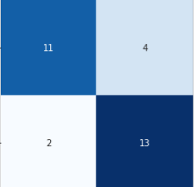
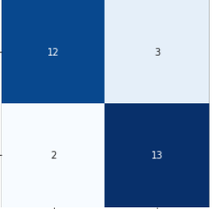
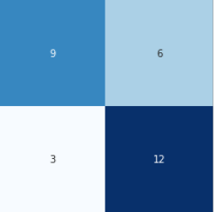
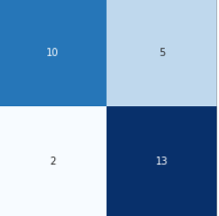
Results analysis :
Confusion Matrix:
Fig: CNN-Transformer
Fig: ConvLSTM
Fig: LRCN
Fig: VGG16-Bi-LSTM
Fig: C3D
True Non Violent
False Non Violent
False Violent
True Violent
Fig: Cell representation

Slide 20
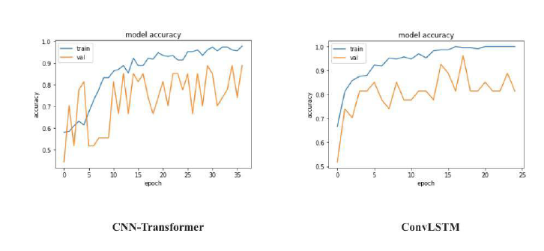
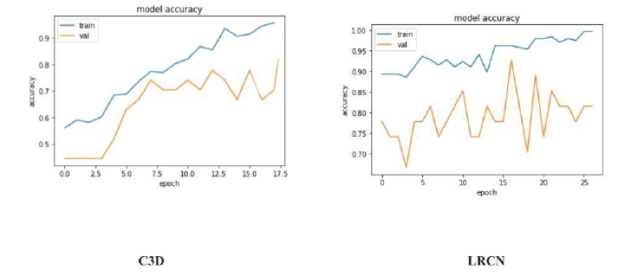
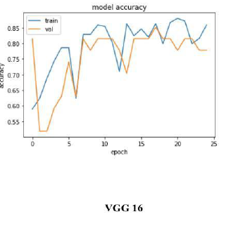
Results analysis :
Train validation Accuracy:
Fig : Train validation Accuracy

Slide 21
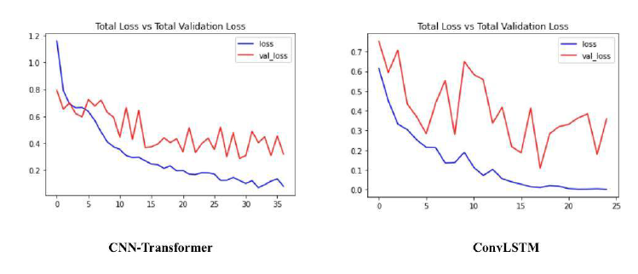
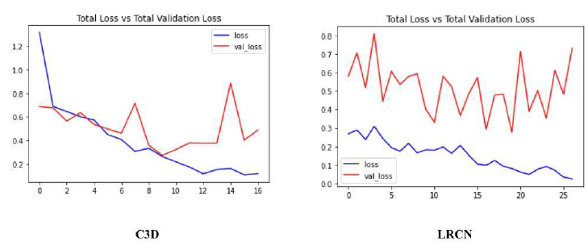
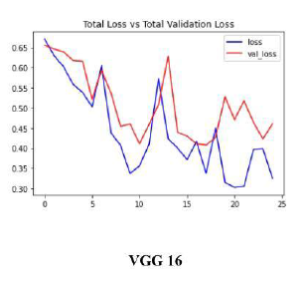
Results analysis :
Train Validation Loss:
Fig : Train Validation loss

Slide 22
Results Analysis
Precision, recall, F-1:
Fig : Precision, recall, F-1

Slide 23
Future Plan
:
Reduce Overfitting
Reduce bias
Convert The models to Tflite models and optimize them with TensorRT

Slide 24
Thank You

